Slide 1
Communicative English Department – Humanities and Social Sciences
Report Writing
Faculty – Dr. Kiran Magavi

Slide 2
Introduction
A report is a written account of something that one has observed, heard, done, or investigated.
It is a systematic and well-organized presentation of facts and findings of an event that has already taken place somewhere.
Reports are divided into sections with headings and subheadings.
Reports can be academic, technical, or business-oriented, and feature recommendations for specific actions.
Reports are written to present facts about a situation, project, or process and will define and analyze the issue at hand.

Slide 3
Difference between report and essay
The key difference between an essay and a report is that -
1. an essay focuses on developing an argument or point of view, while a report centers on solving a problem and presenting research findings.
2. one can also use headings (this is something not done in an essay) to identify sections of the report (i.e., Discussion, Conclusion, etc.).

Slide 4
Types of Reports
Long Report and Short Reports
Internal and External Reports
Vertical and Lateral Reports
Periodic Reports
Formal and Informal Reports
Informational and Analytical Reports
Proposal Reports
Functional Reports
the above to be discussed in part 2 – Report Writing

Slide 5
Importance of reports and report writing
In the world of business, report writing and report writing types are deemed the most research-based writing
It is a highly qualified form of writing that clarifies business process and its modules.
It creates a more desirable understanding of the data and facts for the target audience.
For writing a best report there is crucial need to have a proper understanding about each of its element.
Report writing requires a high skill set as well as an experienced writer who has proper understanding of writing a report.
Contd…

Slide 6
Report Writing is a systematic writing process that requires skills, research and details.
Report writing process is generally a very time-consuming process
It is used in explaining matters or issues informing higher authorities to assist them taking a right decision in regards to the matters or issues.
Main focus of the report writer is to make the whole-thing self explanatory to enlighten the readers about a matter or issue.
Creativity doesn’t play a vital role in report writing.
Report Writing is the dominant tool of media personnel.
They hand over information about any incident or topic in the form of report writing.
Apart from this, it is also required in other sectors like politics, government, corporate etc.

Slide 7
Elements of a good report
A report is a well organized, well planned document that evaluates a subject or problem, and it may include:
The systematic record of ordered events
Explanation of the implication of events
Assessment of the facts of research
Discussion of the outcomes of a course of action
References
Conclusions

Slide 8
Contd…
Reports must always be:
Accurate
Crisp
Understandable
Well-Prepared
Every firm has its own report writing format and hence a writer can’t make use of a specific format for different reports. It is a profession that is catching up now, especially freelance

Slide 9
Formal Report Writing
Formal Report Writing is much complicated and time-consuming. Generally, it demands an enormous research, references, lists, explanation, links and many other things.
These kinds of report writings are usually preferred for important matters, issues or incidents.
It is generally expensive and long.

Slide 10
Informal reports
Informal report writing is easier as compared to formal report writing.
In this kind of writing, extensive research is not required
You just need to focus on the basic things including – Introduction, Discussion & Recommendations.
This report writing has further few types, such as – Credit Report, Progress Report, Feasibility Report, Financial Report, Literary Report, Personal Evaluation and Sales Activity Report.

Slide 11
Steps to write a report
For creating an effective and impressive report, you need to follow the right process.
1. Declare the Objective:
Report Writer needs to keep a clear objective ahead in his mind, why is he creating a report. It assists him/her to stay focused on his report and produce quality outcomes.
2. Understand The Audience:
If you understand your audience, you can definitely be guided to a quality report. Proper understanding can also lead the writer to alter the use of language, supporting material and data incorporated that can elevate the satisfaction for the set audience.
A good understanding makes the writer to present the report that suits their preference.
Contd…..

Slide 12
3. Format Of Report and Types
For producing an effective report, a particular format must be followed, based on parameters like
Oral presentation or written report
Type of report – formal/informal
Technical or problem-solving
Annual or quarterly
Financial
designing of templates for reports makes it easier to prepare reports especially informal reports

Slide 13
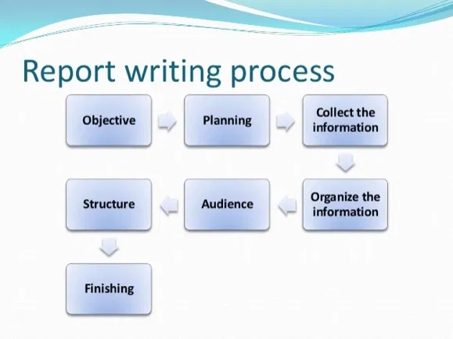

Slide 14
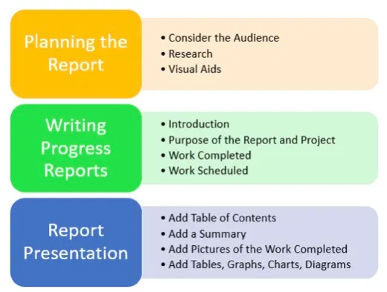

Slide 15
Parts of a project/ research report
Every report should have the following sections
Title page.
Table of contents.
Executive summary.
Introduction.
Discussion.
Conclusion.
Recommendations.
References.

